Slide 1
Student Attendance Management System
Course Instructor: Presented by:
N.AKHILA, M.Tech (Ph.D),
ASSISTANT PROFESSOR,
AIML DEPTARTMENT
25B11AI860 : | ORSU LEELA BHARANI
25B11AI103: | BATHULA N S L DURGA RISHITHA
25B11AI357: | GONDYALA SRIRAM PRAKHYATH
26B21AI027: | ELUBANDI MANIKANTA

Slide 2
Contents
Abstract
Introduction
Problem Statement
Objectives
Novelty of the Project
Modules and Functions
Implementation
C++ Concepts Used
Inputs
Expected Outputs
Flowchart
Team Contribution
Conclusion
References

Slide 3
Project Abstract
The Student Attendance Management System is a simple C++ application designed to manage student attendance efficiently.
Stores student roll number and name
Records date-wise attendance
Marks students as Present or Absent
Calculates attendance percentage
Identifies students with low attendance
Provides a clear attendance summary

Slide 4
Introduction
Attendance management is an important part of academic administration.
Manual attendance records are difficult to maintain and calculate.
This project provides a simple menu-driven C++ application.
It allows faculty to add students, mark attendance, search records and view summaries.
The system demonstrates practical use of Object-Oriented Programming concepts.

Slide 5
Problem Statement & Objectives
Problem Statement
Managing student attendance manually can be time-consuming and difficult to track. Calculating attendance percentages and identifying students with low attendance may also lead to errors.
Objectives
Maintain student attendance date-wise
Reduce manual calculation
Provide quick attendance search
Calculate attendance percentage automatically
Identify students with low attendance
Display a clear attendance summary

Slide 6
Novelty of the Project
Simple and easy-to-use menu-driven interface.
Date-wise attendance is maintained for each student.
Duplicate attendance for the same date is prevented.
Attendance percentage is calculated automatically.
Low-attendance students are identified instantly.
Uses OOP concepts to organize student and attendance data.

Slide 7
Modules / Functions
Student Management Module
addStudent() – Store roll number and student name
findStudent() – Searches for a student by roll number
removeStudent() – Remove students
Attendance Management Module
markAttendance() – Records Present/Absent status.
hasDate() – Checks whether attendance is already marked for a date.
Student::markAttendance() – Stores date and attendance status.
updateAttendance() – Can update already marked attendence
Search Module
searchStudent() – Searches for a student using roll number.
showAttendance() – Displays date-wise attendance records.

Slide 8
Modules / Functions
Attendance Calculation Module
getPresentDays() – Calculates present days.
getAbsentDays() – Calculates absent days.
getPercentage() – Calculates attendance percentage.
Summary Module
showAllSummaries() – Displays summaries of all students.
showSummary() – Displays one student's attendance summary.
Low Attendance Module
showLowAttendance() – Displays students below 75% attendance.
Main/Menu Module
main() – Controls the menu and overall program flow.

Slide 9
Implementation
Developed using C++.
Uses a Student class to store student information.
Uses arrays to store multiple student objects and attendance records.
Maximum capacity:
  50 students
  30 attendance days per student
A menu-driven main() function controls the system.
Attendance status is validated as P/A.
toupper() is used to accept both uppercase and lowercase input.

Slide 10
C++ Concepts Used
Class and Objects – Student class represents student details.
Encapsulation – student data is kept private.
Constructors – default and parameterized constructors are used.
Destructor – demonstrates object destruction.
Static Data Member – totalStudents is shared by all objects.
Arrays – store students, dates and attendance status.
Functions – divide the system into manageable tasks.
Conditional Statements – validate choices and attendance.
Loops – process students and attendance records.
Strings – store names and dates.

Slide 11
Inputs
Student roll number
Student name
Attendance date
Attendance status:
  P – Present
  A – Absent
Menu choice
Roll number for searching

Slide 12
Expected Outputs
Successful student registration message.
Successful attendance marking message.
Date-wise attendance record.
Student attendance percentage.
Present and absent day counts.
List of students below 75% attendance.
Total number of students.
Appropriate validation messages for duplicate or invalid inputs.

Slide 13
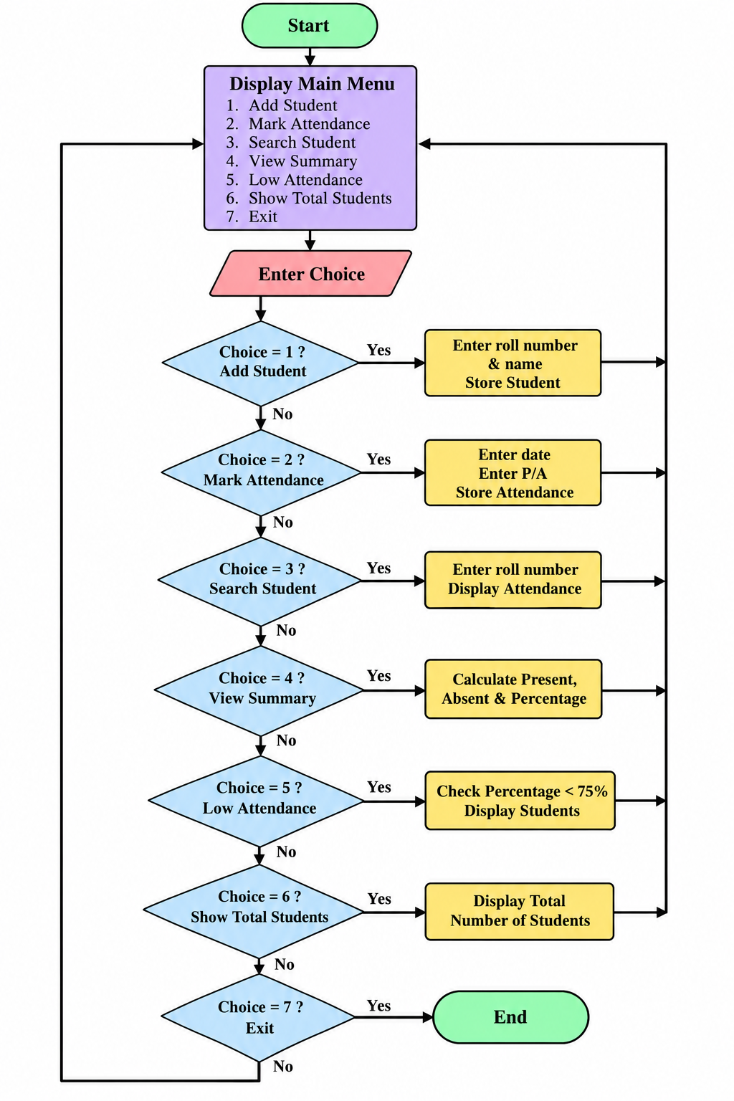
Flowchart

Slide 14
Team Contribution
Roll No. | Name | Role / Responsibility
25B11AI860 | ORSU LEELA BHARANI | Class design, Student & Attendance modules
25B11AI131 | BATHULA N S L DURGA RISHITHA | Coding – core functions & validation
25B11AI357 | GONDYALA SRIRAM PRAKHYATH | Testing, debugging & attendance calculations
26B21AI027 | ELUBANDI MANIKANTA | Documentation & presentation

Slide 15
Conclusion
The Student Attendance Management System simplifies attendance management.
It reduces manual calculation and record-keeping effort.
The system provides quick access to attendance information.
Automatic percentage calculation helps identify low-attendance students.
The project demonstrates practical implementation of C++ OOP concepts.
It can be further extended with file storage, database connectivity and a graphical interface.

Slide 16
References
C++ programming concepts and Object-Oriented Programming course material.
C++ Standard Library documentation.
Class, object, constructor and destructor concepts.
Arrays, strings, functions and control statements in C++.
Project source code and implementation developed for the PBL project.

Slide 17


